Slide 1
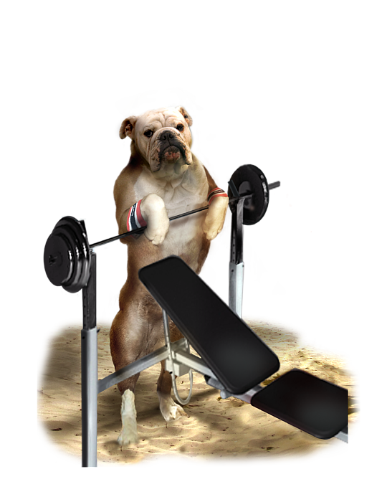
STRENGTHSFINDER

Slide 2
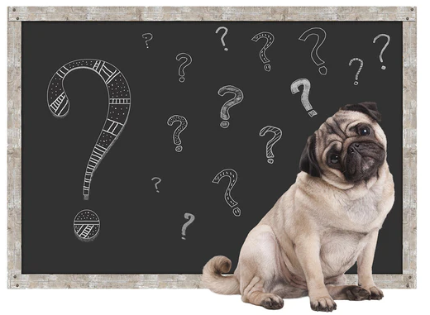
Do you ever wonder…
Why you like certain things?
Why you make certain choices?
Why you do what you do?
Why you are better at some things than others?

Slide 3
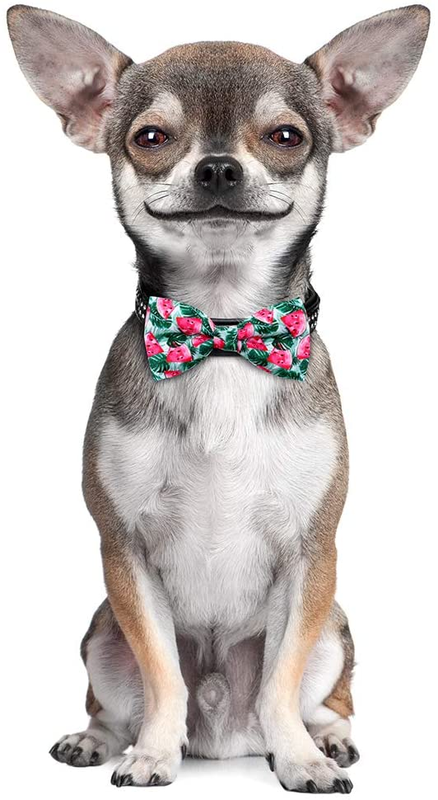
There’s a reason…
It’s your talents!
Talent noun tal•ent
the ways in which you most naturally think, feel, and behave

Slide 4
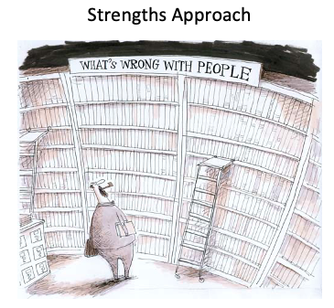
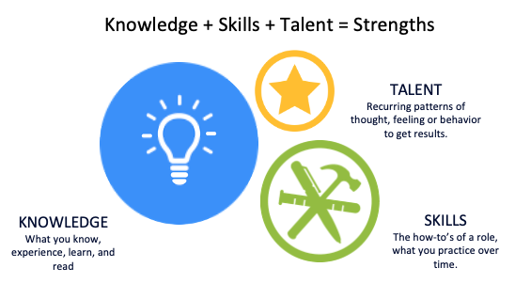
Introduction to StrengthsFinder
What is StrengthsFinder?
An assessment to help identify areas where you and your team have the greatest potential for building strength
Measures recurring patterns of thought, feelings, and behavior
Intended to be a starting point for self-awareness
No single strength is more valuable than any other!
Wrong Assumption: Weakness fixing leads to success
Right Assumption: Weakness fixing prevents failure; strengths development leads to excellence
Notes:
Don Clifton, the inventor of CliftonStrengths, thought that each time a team sat down together, they should get to know one another a little better.
Don believed that for a team to create sustained growth and success, it’s members much continuously invest in one another’s strengths, while building better relationships in the group.
Based on a 40-year study of human strengths, Gallup created a language of the 34 most common themes and developed the Clifton StrengthsFinder assessment to help people discover and describe these themes. The goal was to start a global conversation about what's right with people.

Slide 5
StrengthsFinder Small Group Break Out
Discuss your StrengthsFinders results!
What one thing stood out to you after reading your theme descriptions?
Could be something positive, negative, or something you want to learn more about
What is one blind spot that surprised you in the assessment, and why?
Team 1
Kyle
Daljeet
Julie
Baron
Team 2
Sadie
Michelle
Keelie
Shannon
Team 3
Matti
Lalit
David L.
Notes:
Discuss in small teams – come back together and PLOT TWIST – have each person pick another person on the small team and share what they said surprised them
What are our strengths? Where do we have opportunity as a team?

Slide 6
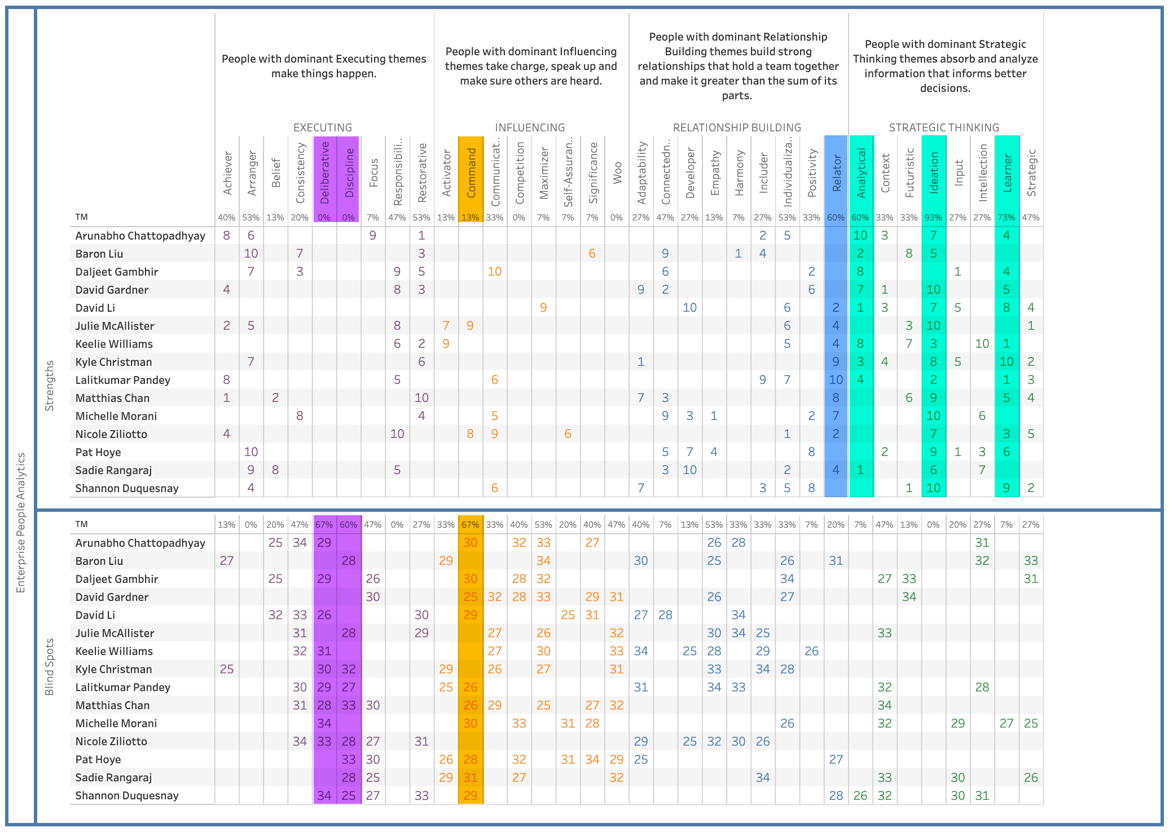
StrengthsFinder Team Grid
Strengths
Blind Spots
Ideation
Learner
Analytical
Relator
Deliberative
Command
Discipline
Tableau Link

Slide 7
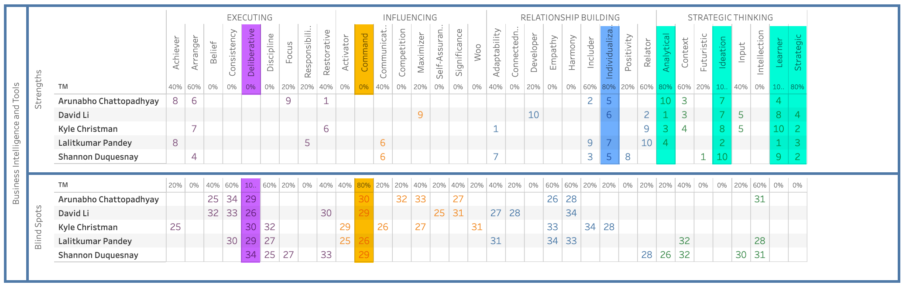
StrengthsFinder Team Grid – Business Intelligence
Strengths
Ideation Learner Strategic Analytical Individualization
Blind Spots
Deliberative Command
Tableau Link

Slide 8
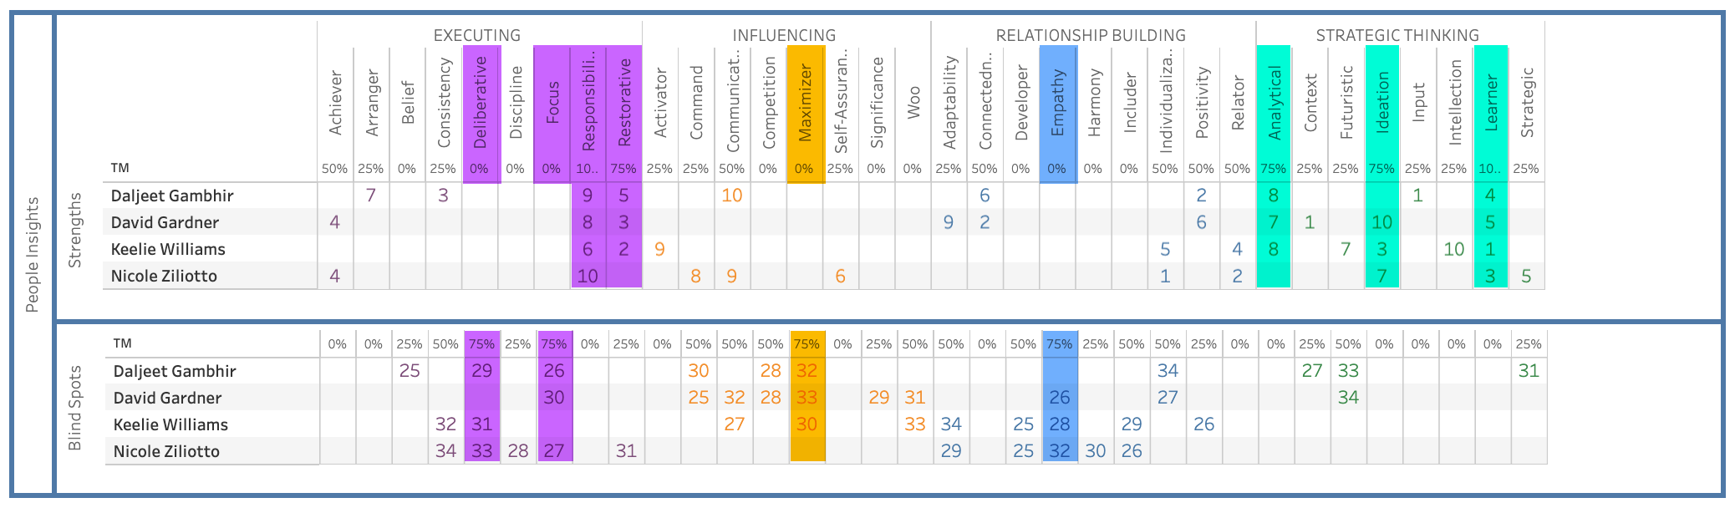
StrengthsFinder Team Grid – People Insights
Strengths
Learner Responsibility Restorative Ideation Analytical
Blind Spots
Deliberative Focus Maximizer Empathy
Tableau Link

Slide 9
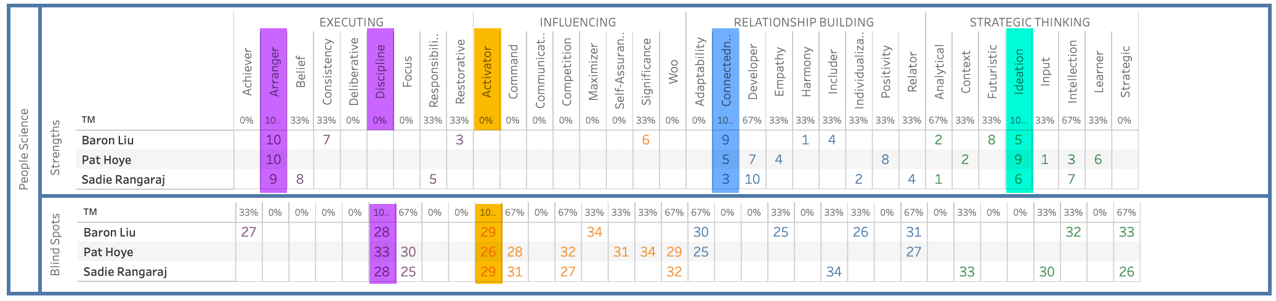
StrengthsFinder Team Grid – People Science
Strengths
Connectedness Ideation Arranger
Blind Spots
Activator Discipline
Tableau Link

Slide 10
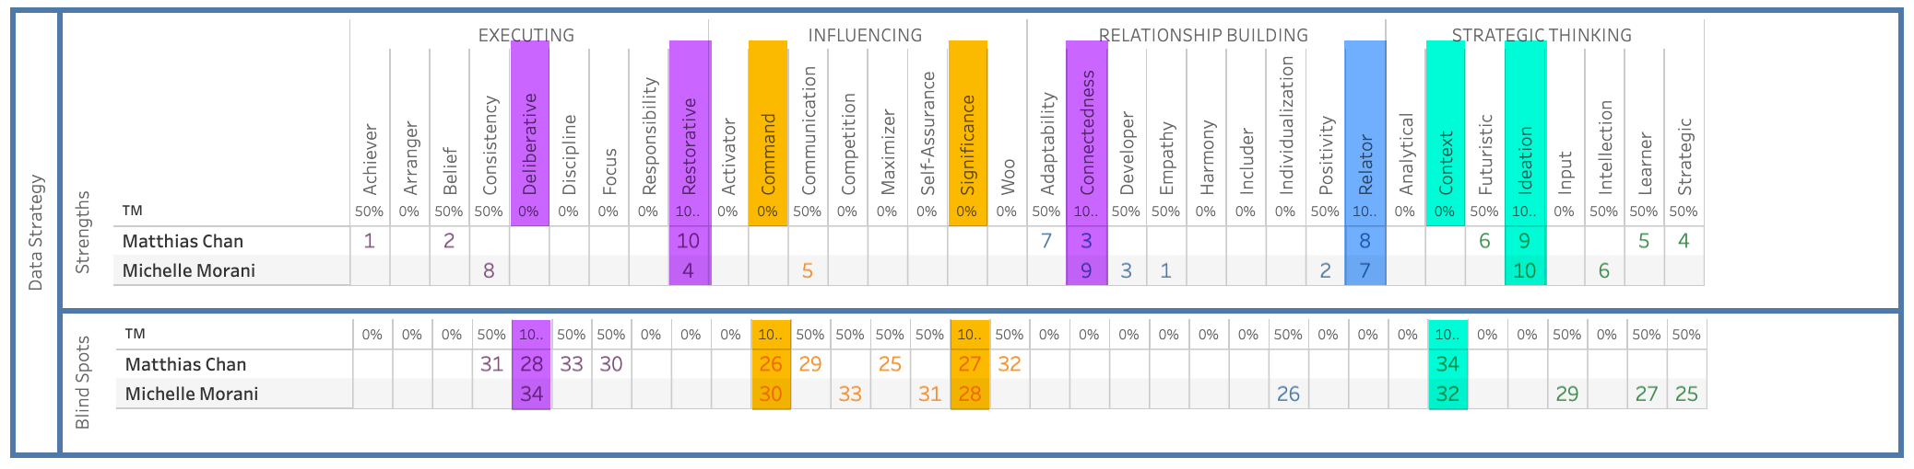
StrengthsFinder Team Grid – Data Strategy
Strengths
Connectedness Restorative Relator Ideation
Blind Spots
Deliberative Command Significance Context
Tableau Link

Slide 11
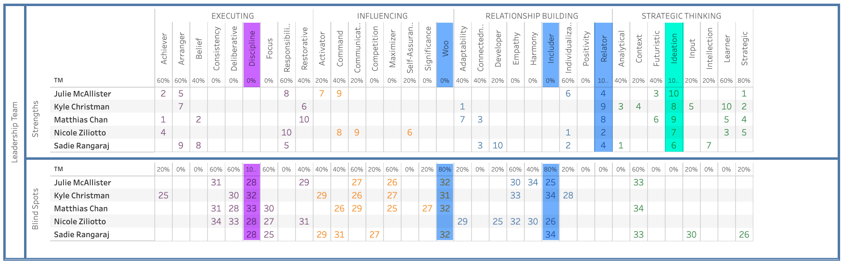
StrengthsFinder Team Grid – Leadership Team
Strengths
Relator Ideation
Blind Spots
Discipline Woo Includer
Tableau Link

Slide 12
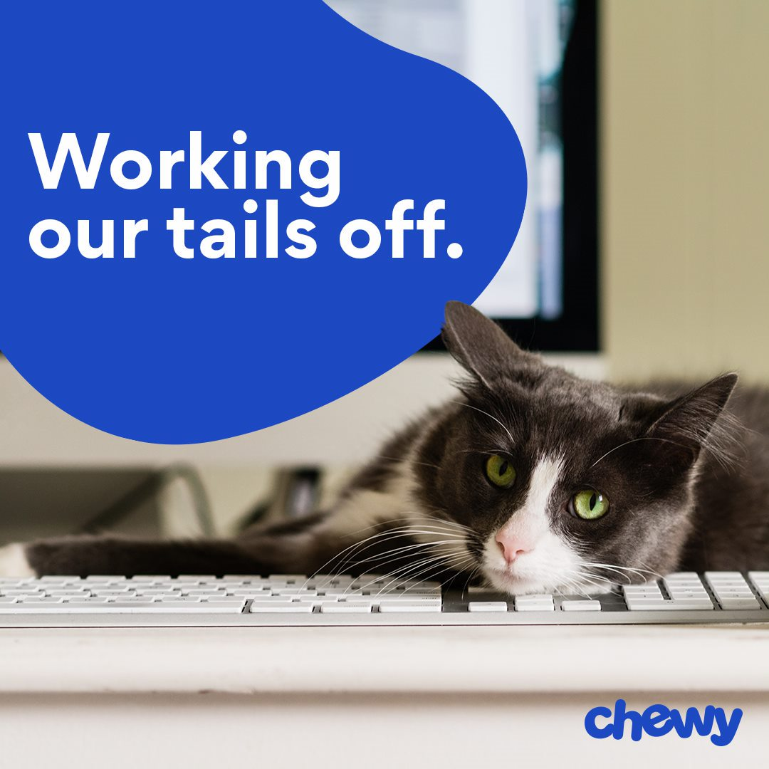
Break Time

Slide 13
StrengthsFinder Hackathon
Each team gets 45 minutes (30 minutes prior to lunch, and 15 minutes after lunch) to take the StrengthsFinder data to see what other types of insights they can find about how our team(s) can work together better
Take the data model on the next slide, and BI Developers and Data Scientists can pull together data into tools, and Insights Managers can look at the data and dig in to see what types of insights you can find
Create 1 slide with your insights and storytelling, and come back ready to present your findings (3-4 minutes per team)
Team 1
David L (BI)
Daljeet (PI)
Sadie (PS)
Team 2
Shannon (BI)
Keelie (PI)
Baron (PS)
Kyle (BI)
Team 3
Lalit (BI)
Nicole (PI)
Michelle (DS)
Team 4 (Virtual)
Arun (BI)
David G (PI)
Pat (PS)

Slide 14

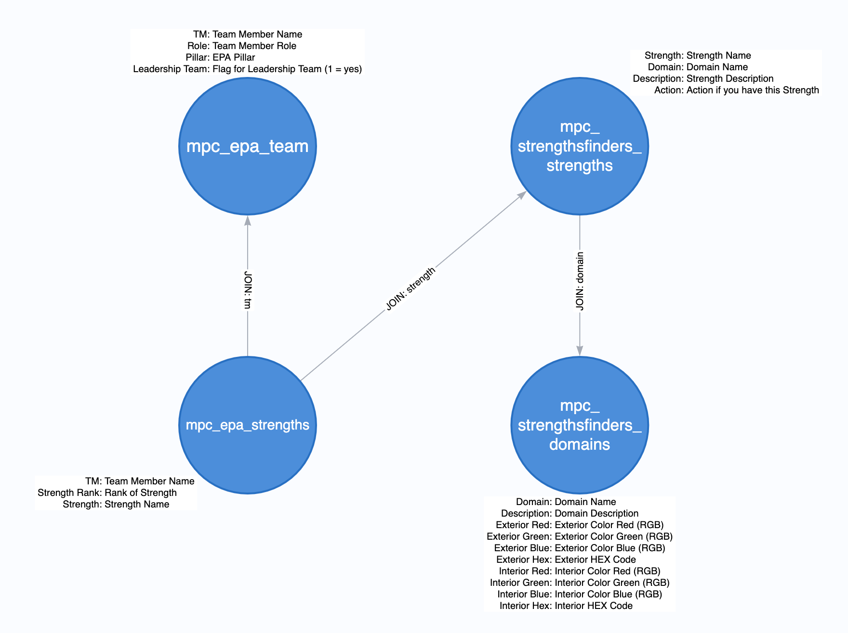
StrengthsFinder Hackathon
Sample Tableau Dashboard:
Data: D_HRDATAMART_SBX.S_ANALYTICS_SBX

Slide 15
Team Breakout Presentations

Slide 16
StrengthsFinder Hackathon
Kyle, Baron, Shannon, Keelie
This model highlights best matches for substitute and complimentary traits.
Substitute: The best pairing based on related traits and scores. Think someone who could cover for you and remain BAU
Complimentary: The best pairing based on the most different traits and scores. Think who would compliment your blind spots with their strengths.

Slide 17
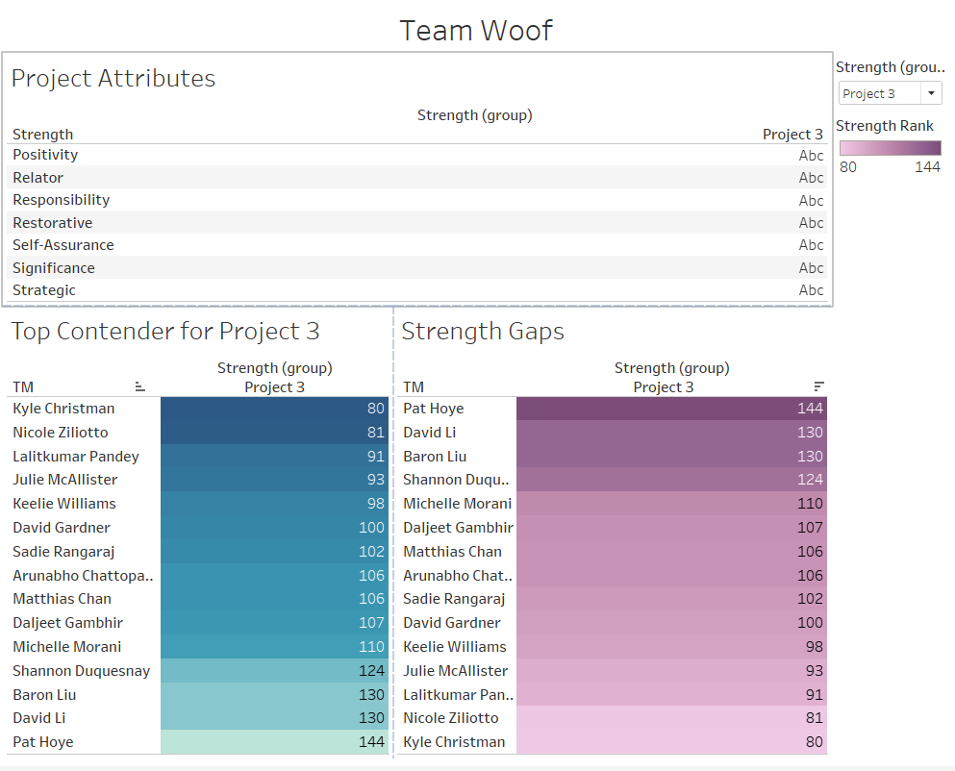
Nicole, Michelle, Lalit
Tableau Link

Slide 18
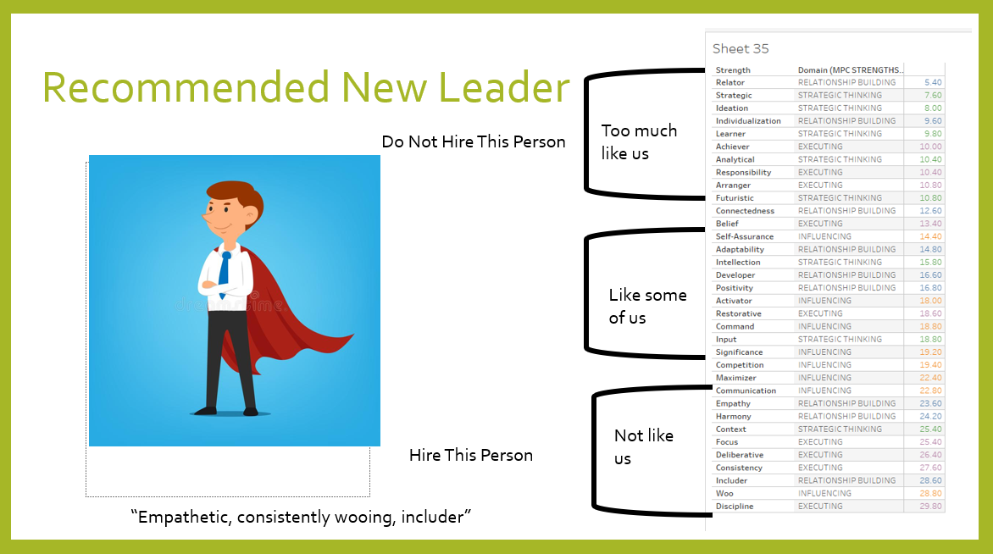
Daljeet, David L, Sadie
Tableau Link

Slide 19
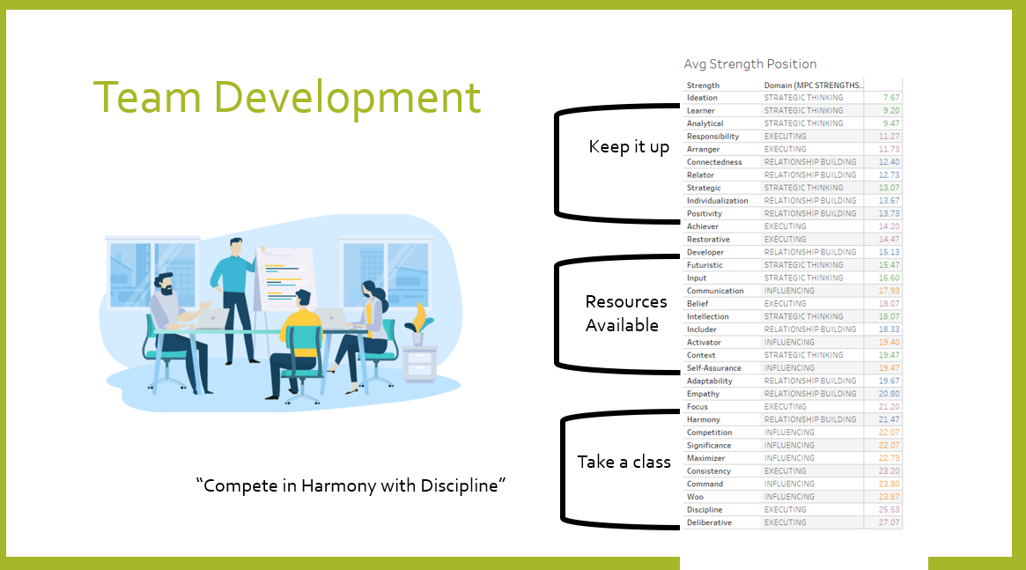
Daljeet, David L, Sadie
Tableau Link

Slide 20
Pat, David G, Arun
The greatest strength for the team by median average is Learner (overall median score of 6.00). Our greatest blind spot by median average is Deliberative (overall median score of 29.00).
- The domain that the team differentiates the most on by score is Executing (difference of 19.00 between top and bottom strength in the domain). The strength of Arranger has a median score of 10.00 but the strength of Deliberative has a median score of 29.00.
- The greatest domain for the team by median average is Strategic Thinking (overall median score of 11.00). Our greatest blind spot domain is Influencing (overall median score of 22.00).
- When you count the number of occurrences of the Top 10 strengths by individual, Ideation occurs the most with 14 instances. The lowest, with a score of 1 instance each, are Significance, Self-Assurance, Maximizer, Harmony and Focus.

